Slide 1
Murach’s C# (8th Edition)
Chapter 7
How to handle exceptions and validate data

Slide 2
Objectives
Applied
Given a form that uses text boxes to accept data from the user, write code that catches any exceptions that might occur.
Given a form that uses text boxes to accept data and the validation specifications for that data, write code that validates the entries.
Use dialogs as needed within your apps.

Slide 3
Objectives (continued)
Knowledge
Explain what an exception is and what it means for an exception to be thrown and handled.
Describe the Exception hierarchy and name two of its subclasses.
Describe the use of try-catch statements to catch specific exceptions as well as all exceptions.
Describe the use of the properties and methods of an exception object.
Describe the use of throw statements.
Describe the three types of data validation that you’re most likely to perform on a user entry.
Describe two ways that you can use generic validation methods in a method that validates all the user entries for a form.

Slide 4
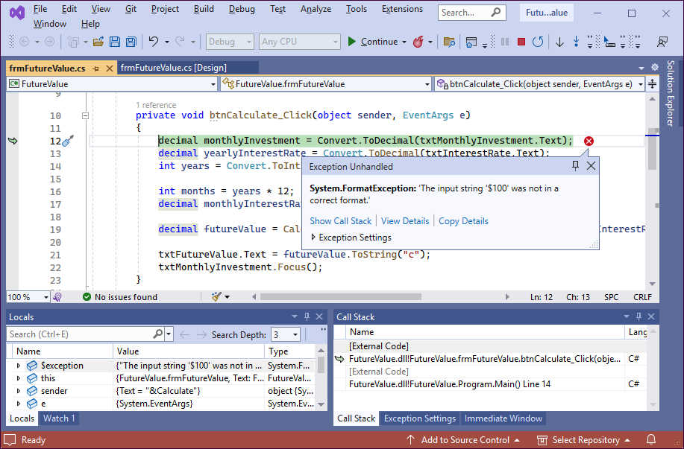
The dialog for an unhandled exception

Slide 5
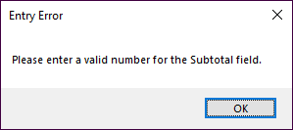
A dialog with an OK button
The statement that displays the dialog
MessageBox.Show(
"Please enter a valid number for the Subtotal field.",
"Entry Error");

Slide 6
A try-catch statement
try
{
decimal subtotal =
Convert.ToDecimal(txtSubtotal.Text);
decimal discountPercent = .2m;
decimal discountAmount = subtotal * discountPercent;
decimal invoiceTotal = subtotal - discountAmount;
}
catch
{
MessageBox.Show(
"Please enter a number for the Subtotal field.",
"Entry Error");
}

Slide 7
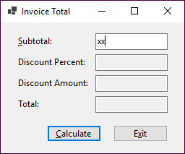
The Invoice Total app with an entry error

Slide 8
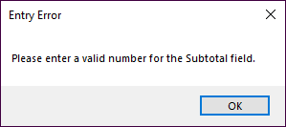
The dialog that’s displayed for the error

Slide 9
A try-catch statement that accesses the exception
try
{
decimal subtotal =
Convert.ToDecimal(txtSubtotal.Text);
}
catch(Exception ex)
{
MessageBox.Show(ex.Message + "\n\n" +
ex.GetType().ToString() + "\n" +
ex.StackTrace, "Exception");
}

Slide 10
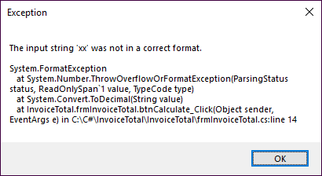
The dialog that’s displayed if an exception occurs

Slide 11
A statement that catches two exceptions
try
{
decimal monthlyInvestment =
Convert.ToDecimal(txtMonthlyInvestment.Text);
decimal yearlyInterestRate =
Convert.ToDecimal(txtInterestRate.Text);
int years = Convert.ToInt32(txtYears.Text);
}
catch(FormatException) // a specific exception
{
MessageBox.Show(
"A format exception has occurred. Check entries.",
"Entry Error");
}

Slide 12
A statement that catches two exceptions (cont.)
catch(OverflowException) // another specific exception
{
MessageBox.Show(
"Overflow exception. Enter smaller values.",
"Entry Error");
}
catch(Exception ex) // all other exceptions
{
MessageBox.Show(ex.Message, ex.GetType().ToString());
}
finally // this runs whether or not an exception occurs
{
PerformCleanup();
}

Slide 13
When to throw an exception
When a method encounters a situation where it isn’t able to complete its task.
When you want to generate an exception to test an exception handler.
When you want to catch the exception, perform some processing, and then throw the exception again.

Slide 14
A method that throws an exception when an exceptional condition occurs
private decimal CalculateFutureValue(
decimal monthlyInvestment,
decimal monthlyInterestRate, int months)
{
if (monthlyInvestment <= 0)
throw new Exception(
"Monthly Investment must be greater than 0.");
if (monthlyInterestRate <= 0)
throw new Exception(
"Interest Rate must be greater than 0.");
...
}

Slide 15
Code that throws an exception for testing
try {
decimal subtotal =
Convert.ToDecimal(txtSubtotal.Text);
throw new Exception(
"An unknown exception occurred.");
}
catch (Exception ex) {
MessageBox.Show(ex.Message + "\n\n"
+ ex.GetType().ToString() + "\n"
+ ex.StackTrace, "Exception");
}

Slide 16
Code that rethrows an exception
try
{
Convert.ToDecimal(txtSubtotal.Text);
}
catch (FormatException fe)
{
txtSubtotal.Focus();
throw fe;
}

Slide 17
Code that uses a throw expression to throw an exception (C# 7.0 or later)
string? productCode = null;
string code = productCode ?? throw new Exception(
"Code cannot be null.");

Slide 18
The code for the Future Value app with exception handling (part 1)
private void btnCalculate_Click(object sender, EventArgs e)
{
try
{
decimal monthlyInvestment =
Convert.ToDecimal(txtMonthlyInvestment.Text);
decimal yearlyInterestRate =
Convert.ToDecimal(txtInterestRate.Text);
int years = Convert.ToInt32(txtYears.Text);
decimal monthlyInterestRate =
yearlyInterestRate / 12 / 100;
int months = years * 12;
decimal futureValue = CalculateFutureValue(
monthlyInvestment, monthlyInterestRate,
months);
txtFutureValue.Text = futureValue.ToString("c");
txtMonthlyInvestment.Focus();
}

Slide 19
The FV app with exception handling (part 2)
catch(FormatException)
{
MessageBox.Show(
"Invalid numeric format. Check all entries.",
"Entry Error");
}
catch(OverflowException)
{
MessageBox.Show(
"Overflow error. Enter smaller values.",
"Entry Error");
}
catch(Exception ex)
{
MessageBox.Show(
ex.Message,
ex.GetType().ToString());
}
}

Slide 20
The FV app with exception handling (part 3)
private decimal CalculateFutureValue(
decimal monthlyInvestment, decimal monthlyInterestRate,
int months)
{
decimal futureValue = 0m;
for (int i = 0; i < months; i++)
{
futureValue = (futureValue + monthlyInvestment)
* (1 + monthlyInterestRate);
}
return futureValue;
}

Slide 21
Code that checks that an entry has been made
if (txtMonthlyInvestment.Text == "")
{
MessageBox.Show(
"Monthly Investment is a required field.",
"Entry Error");
txtMonthlyInvestment.Focus();
}

Slide 22
Code that checks an entry for a valid decimal value
if (!(Decimal.TryParse(txtMonthlyInvestment.Text, out _)))
{
MessageBox.Show(
"Monthly Investment must be valid decimal value.",
"Entry Error");
txtMonthlyInvestment.Focus();
}

Slide 23
Code that checks an entry for a valid range
decimal monthlyInvestment =
Convert.ToDecimal(txtMonthlyInvestment.Text);
if (monthlyInvestment <= 0)
{
MessageBox.Show(
"Monthly Investment must be greater than 0.",
"Entry Error");
txtMonthlyInvestment.Focus();
}
else if (monthlyInvestment >= 1000)
{
MessageBox.Show(
"Monthly Investment must be less than 1,000.",
"Entry Error");
txtMonthlyInvestment.Focus();
}

Slide 24
A method that checks for a required field
private string IsPresent(string value, string name)
{
string msg = "";
if (value == "")
{
msg = name + " is a required field.\n";
}
return msg;
}

Slide 25
A method that checks for a valid numeric format
private string IsDecimal(string value, string name)
{
string msg = "";
if (!Decimal.TryParse(value, out _))
{
msg = name + " must be a valid decimal value.\n";
}
return msg;
}

Slide 26
A method that checks for a valid numeric range
private string IsWithinRange(string value, string name,
decimal min, decimal max)
{
string msg = "";
if (Decimal.TryParse(value, out decimal number))
{
if (number < min || number > max)
{
msg = name + " must be between " +
min + " and " + max + ".\n";
}
}
return msg;
}

Slide 27
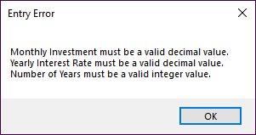
A dialog that displays three error messages

Slide 28
Code that validates multiple entries
private bool IsValidData()
{
bool success = true;
string errorMessage = "";
// Validate the Monthly Investment text box
errorMessage += IsDecimal(txtMonthlyInvestment.Text,
"Monthly Investment");
errorMessage +=
IsWithinRange(txtMonthlyInvestment.Text,
"Monthly Investment", 1, 1000);
// Validate the Yearly Interest Rate text box
errorMessage += IsDecimal(txtInterestRate.Text,
"Yearly Interest Rate");
errorMessage += IsWithinRange(txtInterestRate.Text,
"Yearly Interest Rate", 1, 20);

Slide 29
Code that validates multiple entries (continued)
// Validate the Number of Years text box
errorMessage += IsInt32(txtYears.Text,
"Number of Years");
errorMessage += IsWithinRange(txtYears.Text,
"Number of Years", 1, 40);
if (errorMessage != "")
{
success = false;
MessageBox.Show(errorMessage, "Entry Error");
}
return success;
}

Slide 30
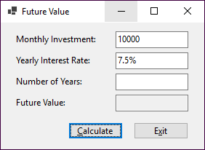
The Future Value form with three invalid fields

Slide 31
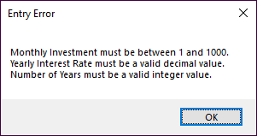
The dialog that displays the errors

Slide 32
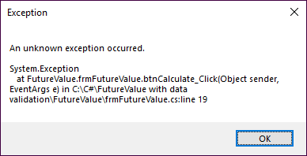
The dialog for an unanticipated exception

Slide 33
The code for the revised Future Value app (part 1)
private void btnCalculate_Click(
object sender, EventArgs e)
{
try
{
if (IsValidData())
{
decimal monthlyInvestment =
Convert.ToDecimal(txtMonthlyInvestment.Text);
decimal yearlyInterestRate =
Convert.ToDecimal(txtInterestRate.Text);
int years = Convert.ToInt32(txtYears.Text);
int months = years * 12;
decimal monthlyInterestRate =
yearlyInterestRate / 12 / 100;
decimal futureValue = CalculateFutureValue(
monthlyInvestment, monthlyInterestRate,
months);

Slide 34
The code for the revised Future Value app (part 2)
txtFutureValue.Text =
futureValue.ToString("c");
txtMonthlyInvestment.Focus();
}
}
catch(Exception ex)
{
MessageBox.Show(ex.Message + "\n\n" +
ex.GetType().ToString() + "\n" +
ex.StackTrace, "Exception");
}
}

Slide 35
The code for the revised Future Value app (part 3)
private bool IsValidData()
{
bool success = true;
string errorMessage = "";
// Validate the Monthly Investment text box
errorMessage += IsDecimal(txtMonthlyInvestment.Text,
"Monthly Investment");
errorMessage +=
IsWithinRange(txtMonthlyInvestment.Text,
"Monthly Investment", 1, 1000);
// Validate the Yearly Interest Rate text box
errorMessage += IsDecimal(txtInterestRate.Text,
"Yearly Interest Rate");
errorMessage += IsWithinRange(txtInterestRate.Text,
"Yearly Interest Rate", 1, 20);

Slide 36
The code for the revised Future Value app (part 4)
// Validate the Number of Years text box
errorMessage += IsInt32(txtYears.Text,
"Number of Years");
errorMessage += IsWithinRange(txtYears.Text,
"Number of Years", 1, 40);
if (errorMessage != "")
{
success = false;
MessageBox.Show(errorMessage, "Entry Error");
}
return success;
}

Slide 37
The code for the revised Future Value app (part 5)
private string IsDecimal(string value, string name)
{
string msg = "";
if (!Decimal.TryParse(value, out _))
{
msg = name + " must be a valid decimal value.\n";
}
return msg;
}

Slide 38
The code for the revised Future Value app (part 6)
private string IsInt32(string value, string name)
{
string msg = "";
if (!Int32.TryParse(value, out _))
{
msg = name + " must be a valid integer value.\n";
}
return msg;
}

Slide 39
The code for the revised Future Value app (part 7)
private string IsWithinRange(string value, string name,
decimal min, decimal max)
{
string msg = "";
if (Decimal.TryParse(value, out decimal number))
{
if (number < min || number > max)
{
msg = name + " must be between " + min
+ " and " + max + ".\n";
}
}
return msg;
}

Slide 40
The code for the revised Future Value app (part 8)
private decimal CalculateFutureValue(
decimal monthlyInvestment, decimal monthlyInterestRate,
int months)
{
decimal futureValue = 0m;
for (int i = 0; i < months; i++)
{
futureValue = (futureValue + monthlyInvestment)
* (1 + monthlyInterestRate);
}
return futureValue;
}

